Slide 1

2025. 05. 28
Super – Resolution on FFT Image
임우리
Uri, LIM
Intern
dladnffl@naver.com

Slide 2

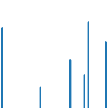




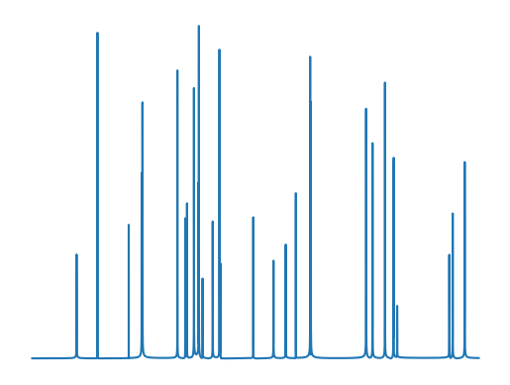
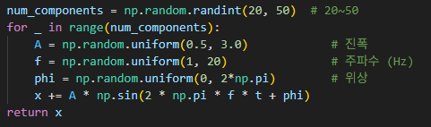
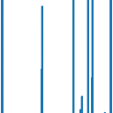
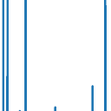

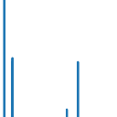




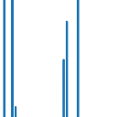
Super – Resolution on FFT
Data
Random signal 생성 → FFT → Patch 저장
2

Slide 3
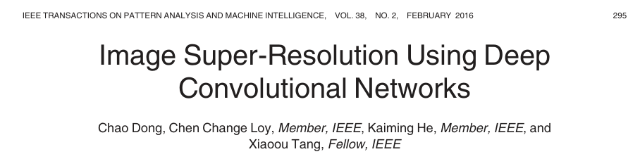
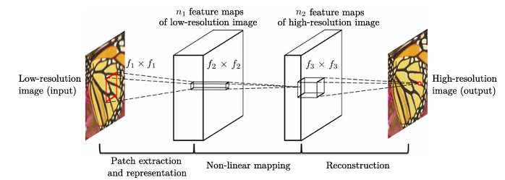
Super – Resolution on FFT
Model
Deep convolutional networks - f1 = 9, f2 = 1, f3 = 5, n1 = 64, and n2 = 32
3

Slide 4
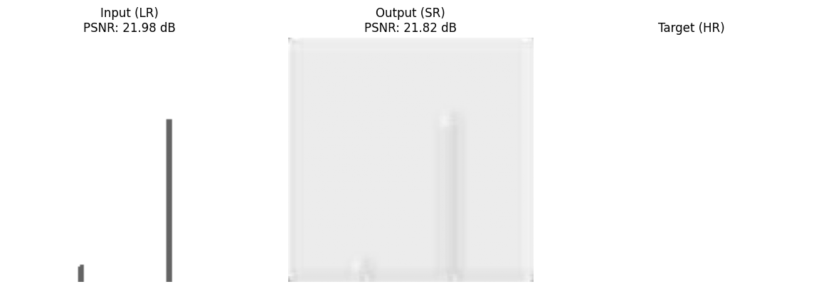
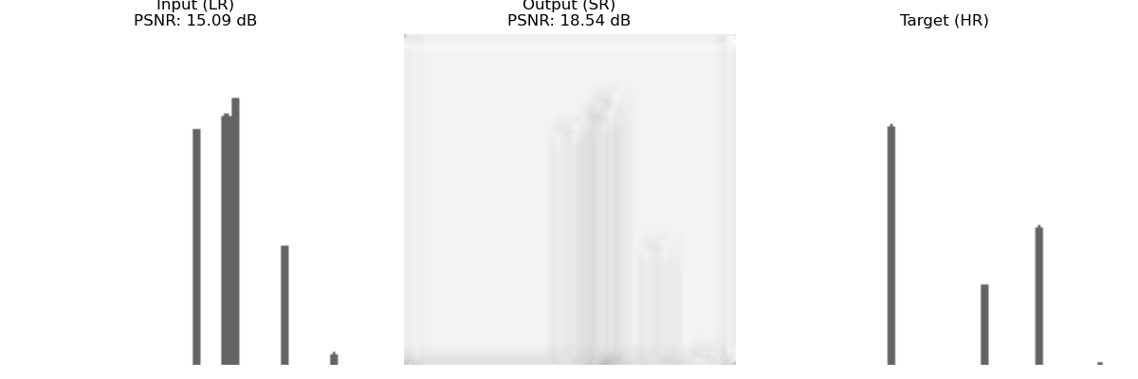
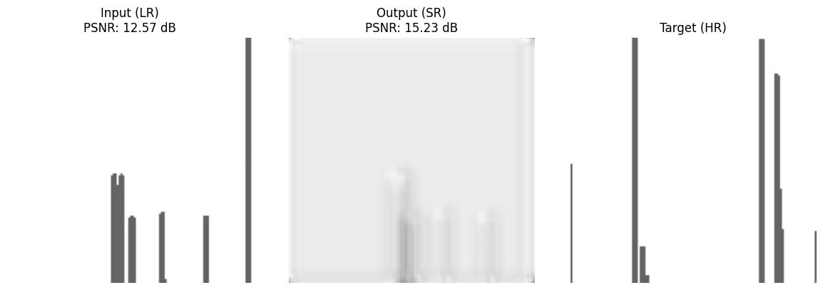
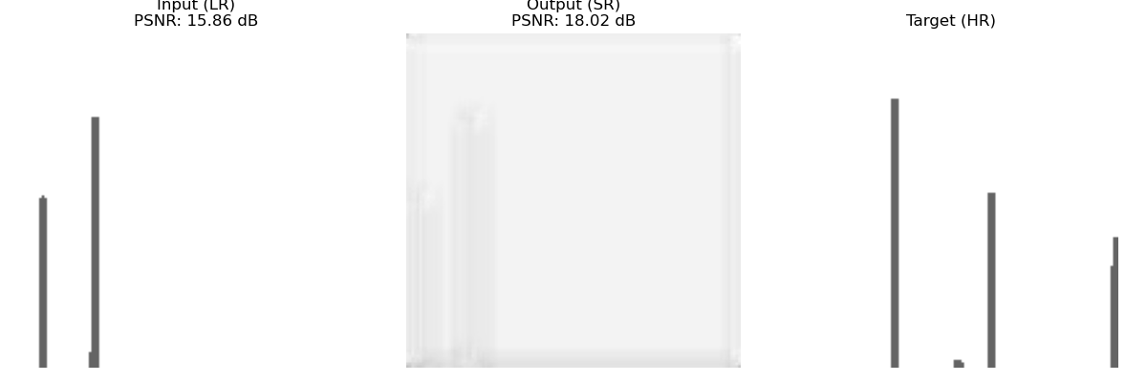
Super – Resolution on FFT
Result
모든 output은 input의 흐린 버전 같은 느낌
Sample 수: 1, Epoch: 50
Sample 수: 100, Epoch: 50
4

Slide 5

Thank you
HAI Lab.
Hyperautomation
Artificial Intelligence (HAI) Lab
hai.snu.ac.kr
5

